Slide 1
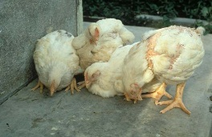
poultry diseases
fourth stage
شعار الكلية
chapter one – Nutritional Deficiency Diseases- lecture 5
Vitamin B Deficiency
Dr.Harith Abdulla
Department of Pathology and Poultry Disease
College of veterinary medicine university of basrah
University of Basrah- College of veterinary medicine- Department of Pathology and Poultry Disease

Slide 2
Introduction
The B complex vitamins are water soluble and not stored to any significant extent in the body. They act in a broad range of metabolic pathways.
Simple deficiency is now rare as diets are usually well supplemented. However, because a continuous supply is required, damage to the intestine or increased demand for some reason may have an effect.

Slide 3
Introduction 2
Most will reduce productivity, including growth in the young animal, and egg production in the layer.
The embryo is particularly dependent on having adequate supplies of vitamins deposited in the egg.
Vitamin deficiencies are especially prone to cause problems of hatchability.

Slide 4
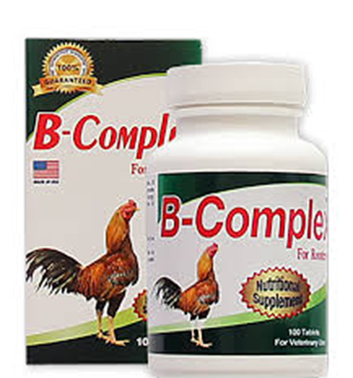
Vitamin B Deficiency
1-Pantothenic acid and Biotin Deficiency.
2- Thiamine Deficiency ( B1 Deficiency ).
3- Riboflavin ( B2) Deficiency .

Slide 5
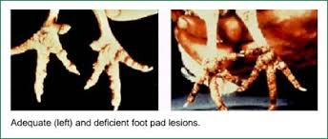
1-Chick Dermatitis (Pantothenic acid and Biotin Deficiency )

Slide 6
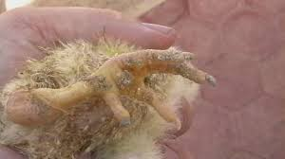
Chick Dermatitis
An inflammation of the unfeathered parts of
chicks and poults caused by deficiency of
vitamin B5 ( pantothenic acid) and biotin.
Symptoms:
1-Slow growth and rigid feathers.
2-Low hatchability and high embryonic
mortality.

Slide 7
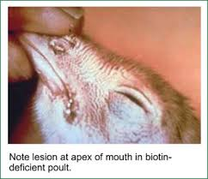
Post-mortem lesions:
1-Pus like substance in the mouth and grayish white exudates in the prventriculus.
2-Scabby lesions at the corners of the mouth, edge of eyelids, around the vent and bottom of the feet ( Dermatitis).
3- Liver is hypertrophied , spleen sometimes
atrophied.
Treatment:
Injection or oral
administration of
the vitamin.

Slide 8
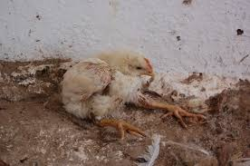
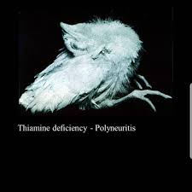
2- Thiamine Deficiency ( B1 Deficiency )
( Polynuritis )
Function of Thiamine ( B1) Thiamine is required by poultry for the metabolism of carbohydrate.
In birds, vitamin B1, (thiamine) deficiency is clinically and morphologically manifested with Stargazing

Slide 9
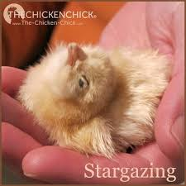
Symptoms:
1-Symptoms appear in 2-3 weeks after chicks were placed on thiamine deficient diet.
2-Anorexia followed by loss of weight, leg weakness and unsteady gait.
3-Paralysis of muscles of legs, wings and neck.
4-The chicken characteristically
sits on its flexed legs and
draws the head back in a
*Stargazing* position.

Slide 10
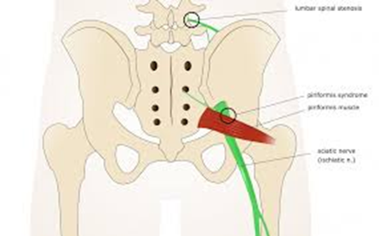
Post-mortem lesions: Bilateral enlargement of nerves(Sciatic ).
Treatment :
The bird response quickly with oral administration
of thiamine.

Slide 11
3- Riboflavin ( B2) Deficiency
(Curled Toe Paralysis)
is characterized with impaired oxidation processes and dystrophic changes in the peripheral nerves.

Slide 12
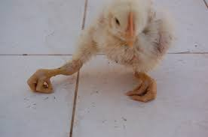
Curled Toe Paralysis:
Is a nutritional disease
caused by vitamin B2
deficiency.
Symptoms:
1-Age : 3-4 weeks.
2-Diarrhea develops between the first and second
week.
3-The chicks do not walk unless forced, and walk
with the aid of wings.

Slide 13
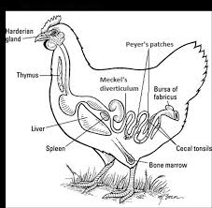
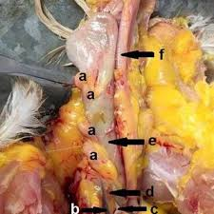
Post-mortem lesions:
1-Atrophied thymus gland.
2-Enlargement of nerves,
4-5 times, due to edema.
3- Notched beak.
Treatment:
High riboflavin diet.

